Slide 1
GPSC_LIM food web
Part 2: Model construction

Slide 2
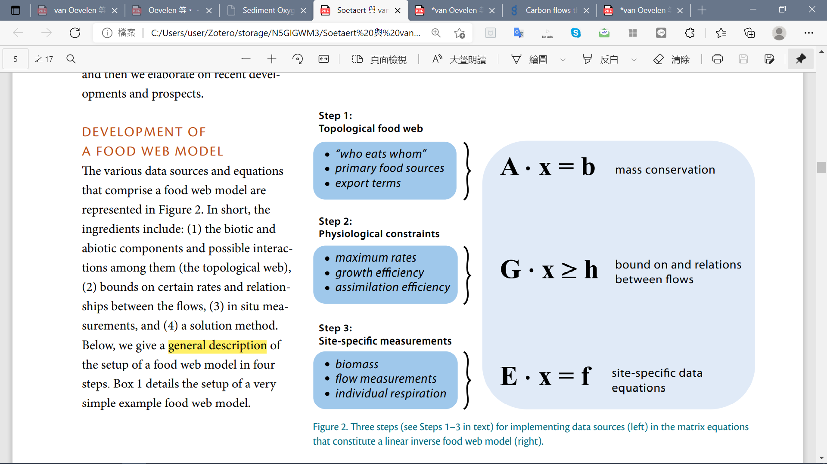
Development of a linear inverse model

Slide 3
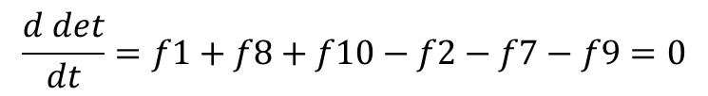
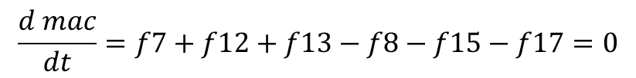
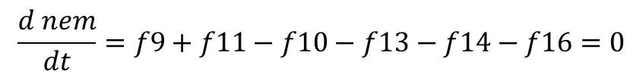
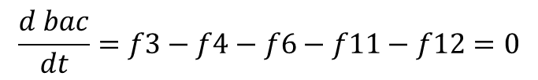
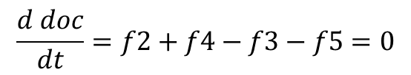
Development of a linear inverse model
det_w
doc_w
dic_w
f1
f5
f6
f15
det
f14
$$\frac{d det}{dt}=f1+f8+f10−f2−f7−f9=0$$
f10
f2
f9
f7
$$\frac{d doc}{dt}=f2+f4−f3−f5=0$$
doc
nem
f16
exp
$$\frac{d bac}{dt}=f3−f4−f6−f11−f12=0$$
f4
f3
f13
f17
f11
f8
$$\frac{d nem}{dt}=f9+f11−f10−f13−f14−f16=0$$
bac
mac
f12
$$\frac{d mac}{dt}=f7+f12+f13−f8−f15−f17=0$$
All mass balances are assumed to be in steady state

Slide 4
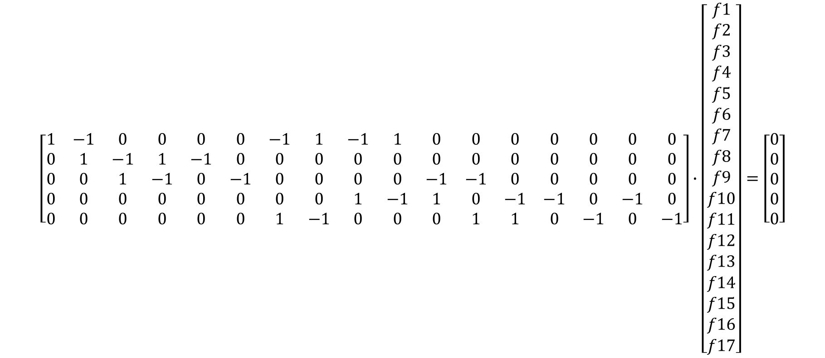
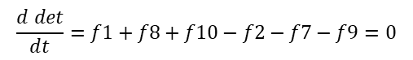
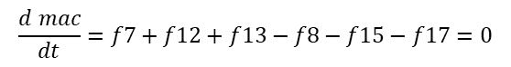
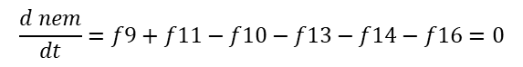
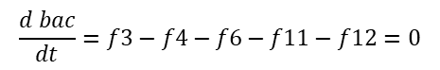
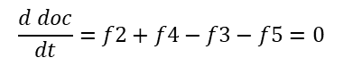
Development of a linear inverse model
$$\frac{d det}{dt}=f1+f8+f10−f2−f7−f9=0$$
Unknown flows
$$\frac{d doc}{dt}=f2+f4−f3−f5=0$$
$$\frac{d bac}{dt}=f3−f4−f6−f11−f12=0$$
x
$$\frac{d nem}{dt}=f9+f11−f10−f13−f14−f16=0$$
$$\left[\begin{matrix}\begin{matrix}\begin{matrix}\begin{aligned}1 \\ 0 \\ 0 \\ 0 \\ 0\end{aligned} & \begin{aligned}−1 \\ 1 \\ 0 \\ 0 \\ 0\end{aligned} & \begin{aligned}0 \\ −1 \\ 1 \\ 0 \\ 0\end{aligned}\end{matrix} & \begin{aligned}0 \\ 1 \\ −1 \\ 0 \\ 0\end{aligned} & \begin{aligned}0 \\ −1 \\ 0 \\ 0 \\ 0\end{aligned}\end{matrix} & \begin{matrix}\begin{aligned}0 \\ 0 \\ −1 \\ 0 \\ 0\end{aligned} & \begin{aligned}−1 \\ 0 \\ 0 \\ 0 \\ 1\end{aligned} & \begin{aligned}1 \\ 0 \\ 0 \\ 0 \\ −1\end{aligned}\end{matrix} & \begin{matrix}\begin{aligned}−1 \\ 0 \\ 0 \\ 1 \\ 0\end{aligned} & \begin{aligned}1 \\ 0 \\ 0 \\ −1 \\ 0\end{aligned} & \begin{matrix}\begin{aligned}0 \\ 0 \\ −1 \\ 1 \\ 0\end{aligned} & \begin{aligned}0 \\ 0 \\ −1 \\ 0 \\ 1\end{aligned} & \begin{matrix}\begin{aligned}0 \\ 0 \\ 0 \\ −1 \\ 1\end{aligned} & \begin{aligned}0 \\ 0 \\ 0 \\ −1 \\ 0\end{aligned} & \begin{matrix}\begin{aligned}0 \\ 0 \\ 0 \\ 0 \\ −1\end{aligned} & \begin{aligned}0 \\ 0 \\ 0 \\ −1 \\ 0\end{aligned} & \begin{aligned}0 \\ 0 \\ 0 \\ 0 \\ −1\end{aligned}\end{matrix}\end{matrix}\end{matrix}\end{matrix}\end{matrix}\right]∙\left[\begin{aligned}f1 \\ f2 \\ f3 \\ f4 \\ f5 \\ f6 \\ f7 \\ f8 \\ f9 \\ f10 \\ f11 \\ f12 \\ f13 \\ f14 \\ f15 \\ f16 \\ f17\end{aligned}\right]=\left[\begin{aligned}0 \\ 0 \\ 0 \\ 0 \\ 0\end{aligned}\right]$$
$$\frac{d mac}{dt}=f7+f12+f13−f8−f15−f17=0$$
A
b
5 x 17
5 x 1
All mass balances are assumed to be in steady state (i.e. b=0)
17 x 1

Slide 5
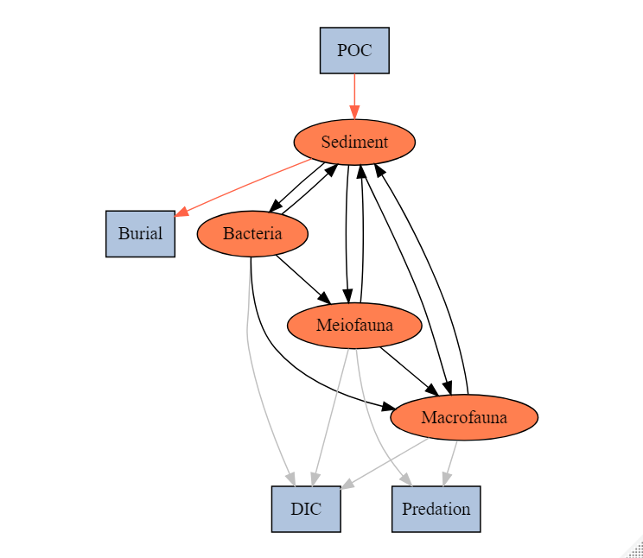
Topological food web structure
SYM | MEANING
POC->SED | Organic matter derived from the water column
SED->EXP_S | Sediment export(e.g. downslope, burial…)
SED->BAC | Bacteria feed on detritus OC
BAC->SED | Bacteria feces deposit on sediment
SED->MEI | Meiofauna feed on detritus OC
MEI->SED | Meiofauna feces deposit on sediment
SED->MAC | Macrofauna feed on detritus OC
MAC->SED | Macrofauna feces deposit on sediment
BAC->MEI | Meiofauna feed on bacteria
BAC->MAC | Macrofauna feed on bacteria
MEI->MAC | Macrofauna feed on meiofauna
MEI->EXP_B | Meiofauna predated by other benthopelagic/pelagic predators
MAC->EXP_B | Macrofauna predated by other benthopelagic/pelagic predators
BAC->DIC | Bacteria respiration
MEI->DIC | Meiofauna respiration
MAC->DIC | Macrofauna respiration
abiotic
biotic
Internal flows
Exchange with external

Slide 6
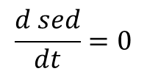
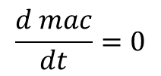
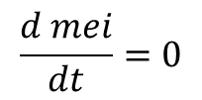
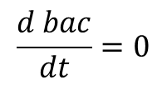
Ax=b
Mass conservation
abiotic
$$\frac{d sed}{dt}=0$$
biotic
$$\frac{d bac}{dt}=0$$
$$\frac{d mei}{dt}=0$$
$$\frac{d mac}{dt}=0$$
Internal flows
Exchange with external

Slide 7
Dealing with respiration problem
LSEI error: inequalities contradictory
Using equalities and/or inequalities that are incompatible.
eg.: I want that a > 10 but also that a < 2
Directly use measured TOU data
Calculated based on allometric relationships and temp (Mahaut et al 1995)
LSEI error
Only assume maintenance respiration
(van Oevelen)
Successfully run
Use speculated respiration rate
Compare results

Slide 8
Dealing with respiration problem
Calculated based on allometric relationships and temp (Mahaut et al 1995)
A. Weight-dependent respiration rates:
BIO->DIC (R) = 7.4*10^-3*Stock(W)^(-0.24)
! Exponential function is not allowed in LIM.input file, so R is calculated base on the initial stock (this is not a dynamic model)
B. Maintenance Respiration(mr)= Tlim * 0.01 * STOCK
Maintenance costs are taken proportional to 1% of the biomass per day (Fenchel, 1982; Nielsen et al., 1995)
Growth respiration(gr)= BIO->DIC-mr
Other processes
Assimilation efficiency (AE)= (Consumption-Defecation)/Consumption
Net growth efficiency (NGE)=(Consumption-Defecation-gr)/ (Consumption-Defecation)
(Consumption-Defecation-gr)/Stock= P/B ratio
Only assume maintenance respiration (MR)
(van Oevelen)
Use reference respiration rate
C. BIO->DIC= biomass-specific faunal respiration rate (bsFR)*Stock

Slide 9
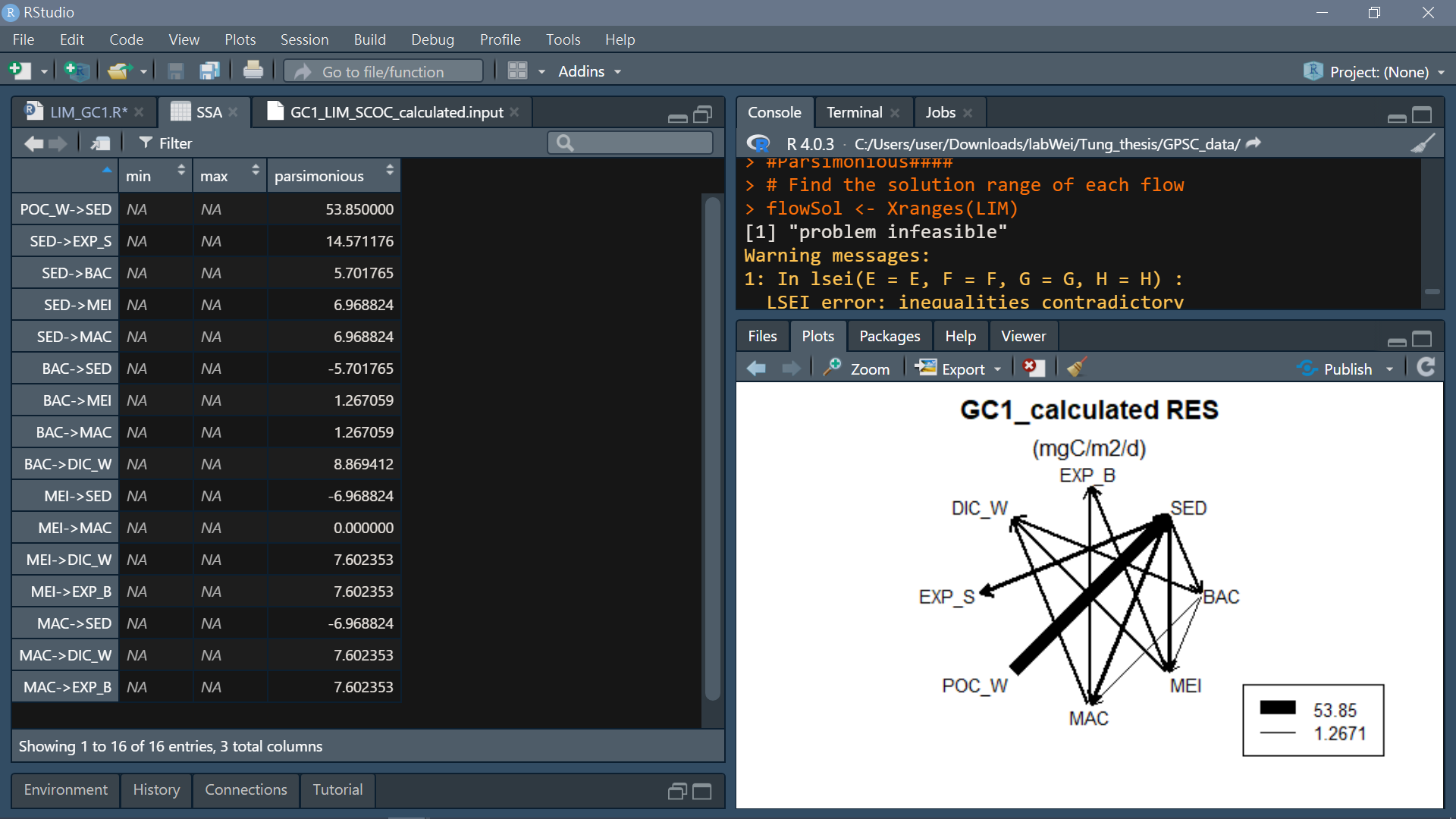
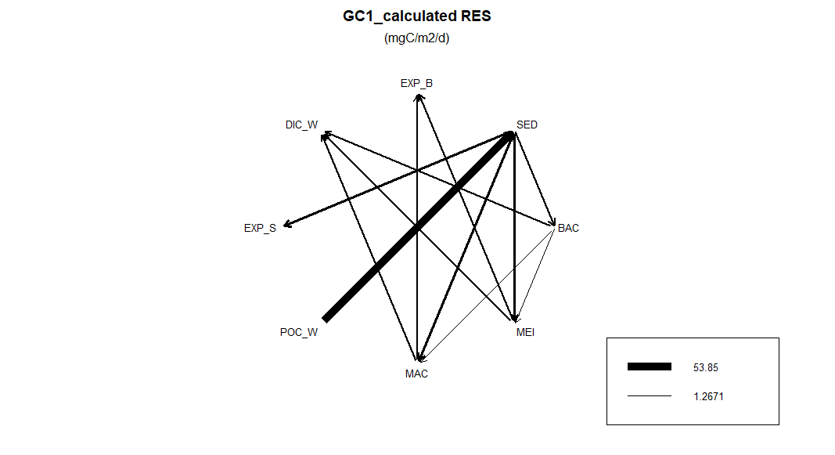
SSA Result:
LSEI error
BAC: 30% of TOU
MEI: 7.4*10^-3*MEISS^-0.24
MAC: 7.4*10^-3*MACSS^-0.24
→ set less limits
→ keep:
MEI: 7.4*10^-3*MEISS^-0.24
MAC: 7.4*10^-3*MACSS^-0.24 →problem unsolved

Slide 10
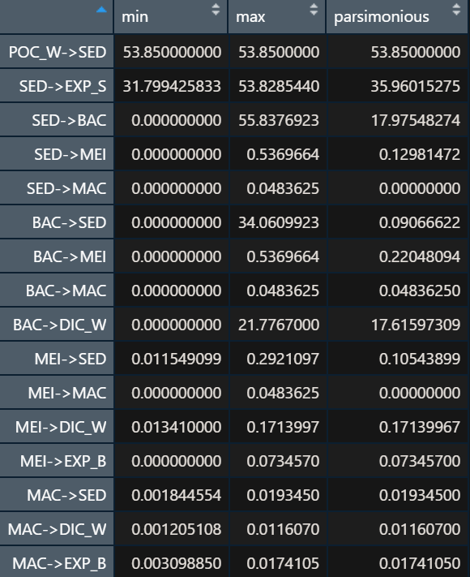
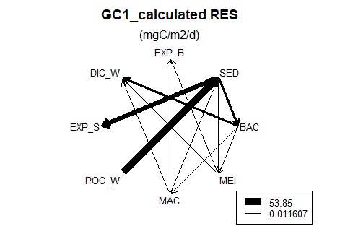
SSA Result:
→ keep:
BAC: 30% of TOU

Slide 11
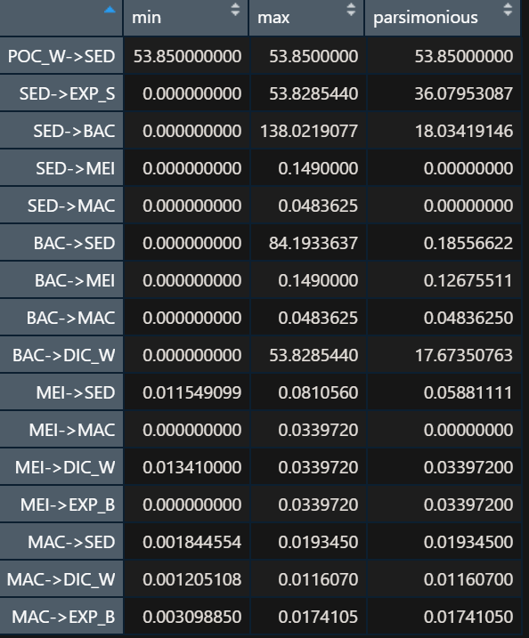
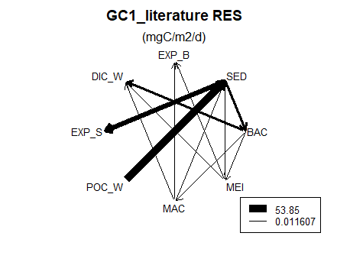
SSA Result:

Slide 12
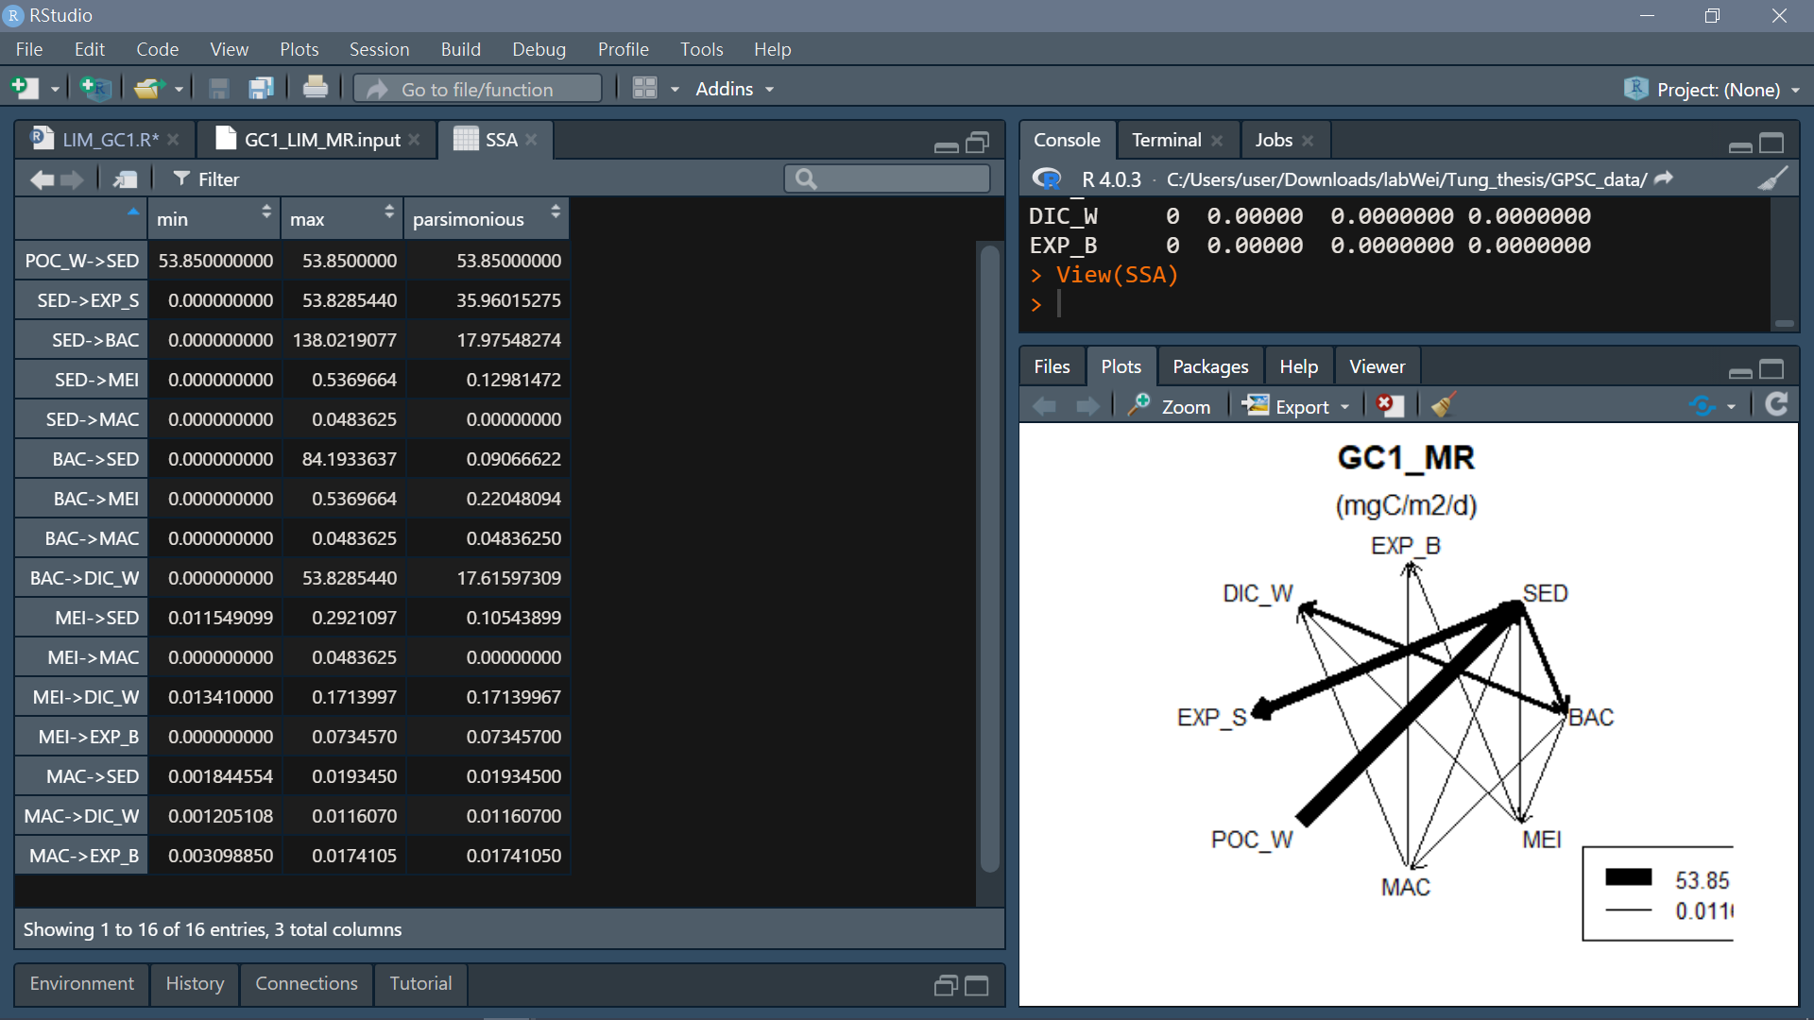
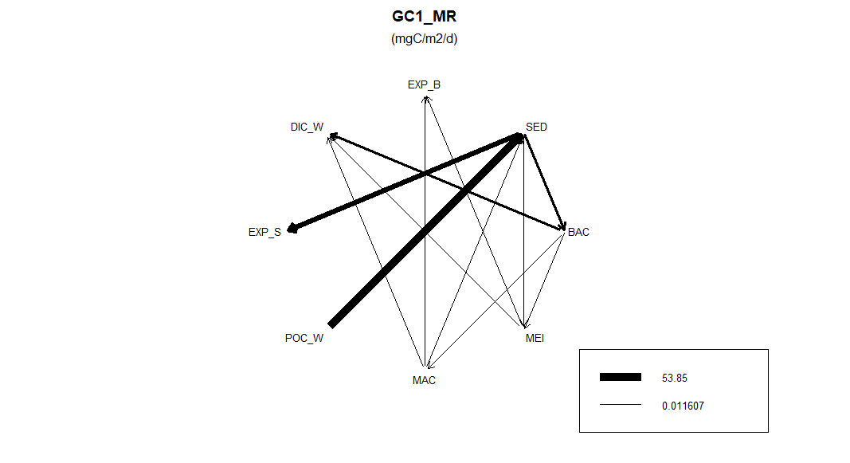
SSA Result:
Station | Bottom water temperature(°C) | Tlim
GC1 | 13.54 | 1.05
GS1 | 13.90 | 1.09
Tlim = Q10* exp((T-20)/10), with Q10 = 2

Slide 13
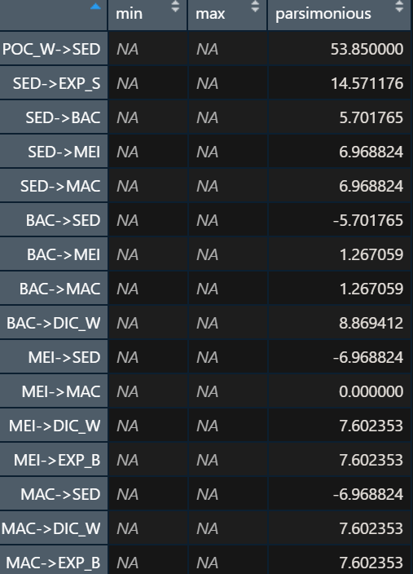
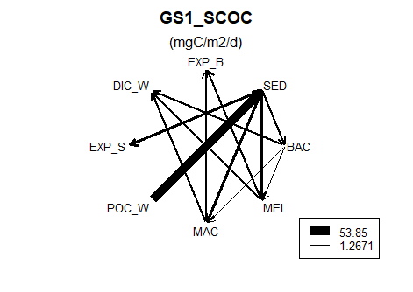
SSA Result:
LSEI error
BAC: 30% of TOU
MEI: 7.4*10^-3*MEISS^-0.24
MAC: 7.4*10^-3*MACSS^-0.24
→ set less limits
→ keep:
MEI: 7.4*10^-3*MEISS^-0.24
MAC: 7.4*10^-3*MACSS^-0.24 →problem unsolved

Slide 14
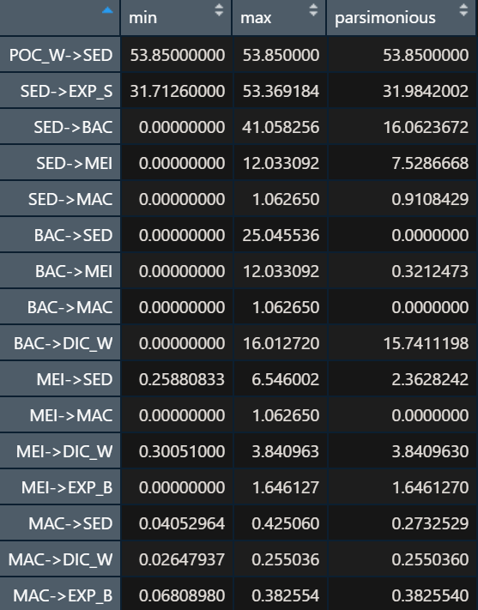
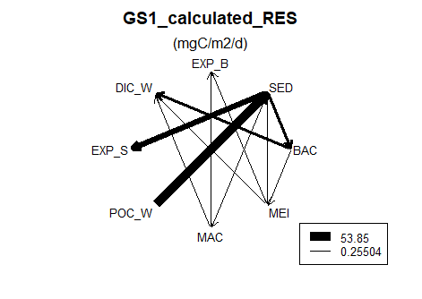
SSA Result:
→ keep:
BAC: 30% of TOU

Slide 15
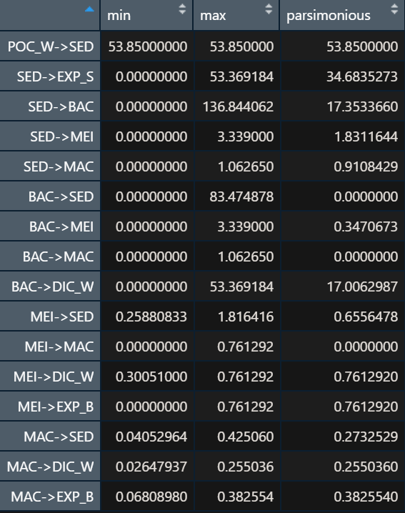
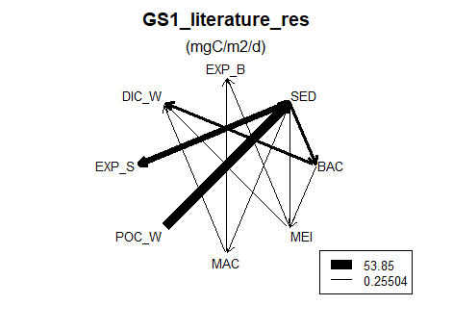
SSA Result:

Slide 16
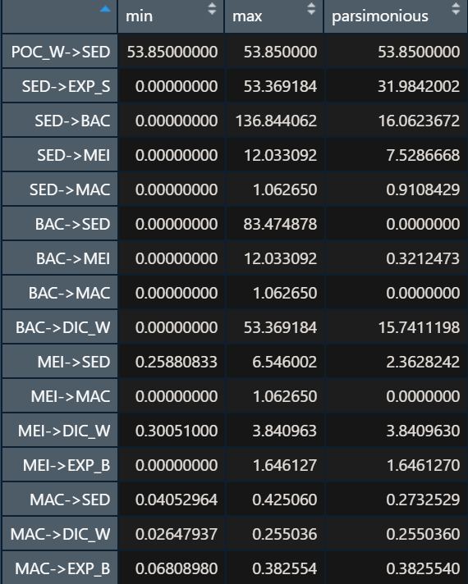
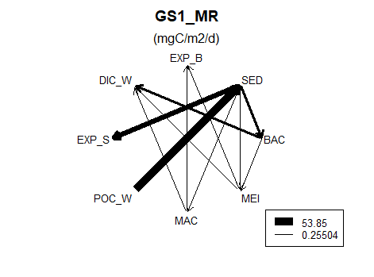
SSA Result:
Station | Bottom water temperature(°C) | Tlim
GC1 | 13.54 | 1.05
GS1 | 13.90 | 1.09
Tlim = Q10* exp((T-20)/10), with Q10 = 2

Slide 17
SSA Result:
Summary (for both GS1 and GC1 model):
Direct use TOU data -> LSEI error
Include BAC (=30% TOU) and MAC/MEI(=7.4*10^-3*Stock^-0.24) respiration data->LSEI error
Only include BAC (=30% TOU) data -> successfully run
Use literature respiration rate -> successfully run
Use maintenance respiration rate -> successfully run
Results of (3) and (5) are the same->combine 2 input file to one
Compare (4) and (6) -> no difference

Slide 18
Before compare results from different methods
if the number of iterations is high enough to produces convergence of the mean and the standard deviation
standard deviation < 2%
Check at least 3 different magnitude flows
if the range of sampled values cover the range of possible solutions
>75% of the flows has a sampled range of >75% of the solution range
Iteration=10000; jumpsize=100

Slide 19
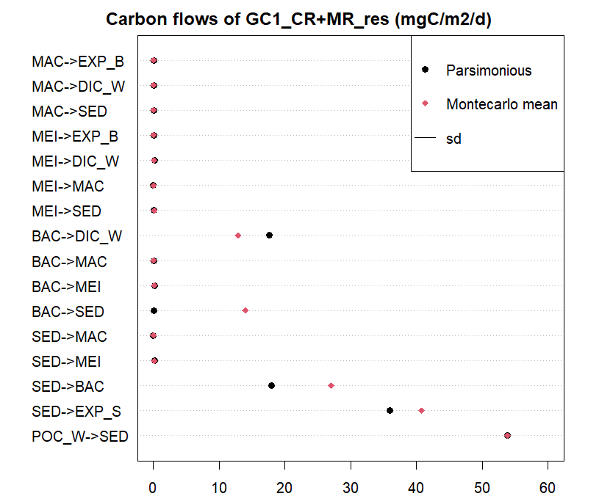
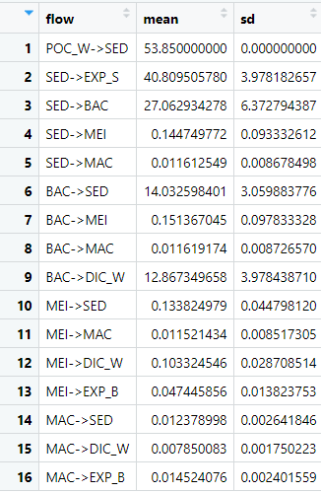
LA Result:
if the range of sampled values cover the range of possible solutions?
Mean sample coverage: 83.28

Slide 20
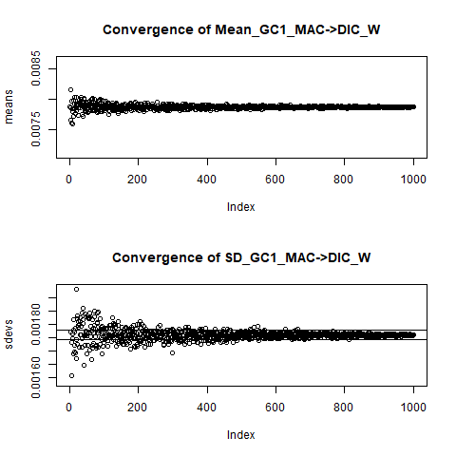
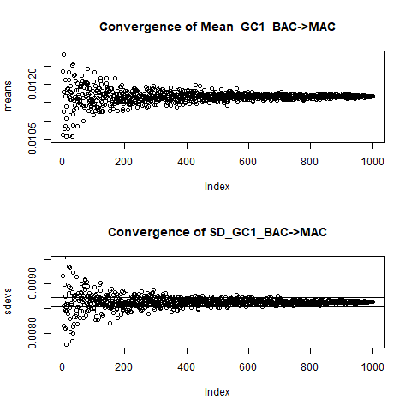
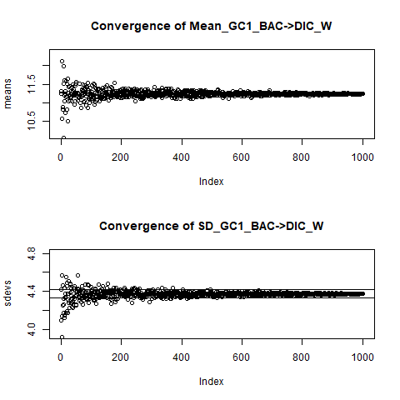
if the number of iterations is high enough to produces convergence of the mean and the standard deviation?
standard deviation < 2%
Check at least 3 different magnitude flows

Slide 21
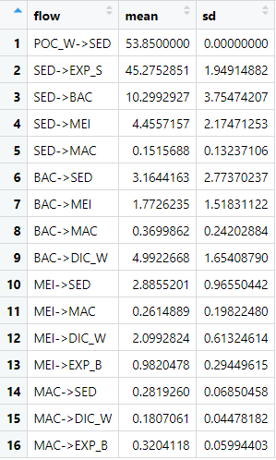
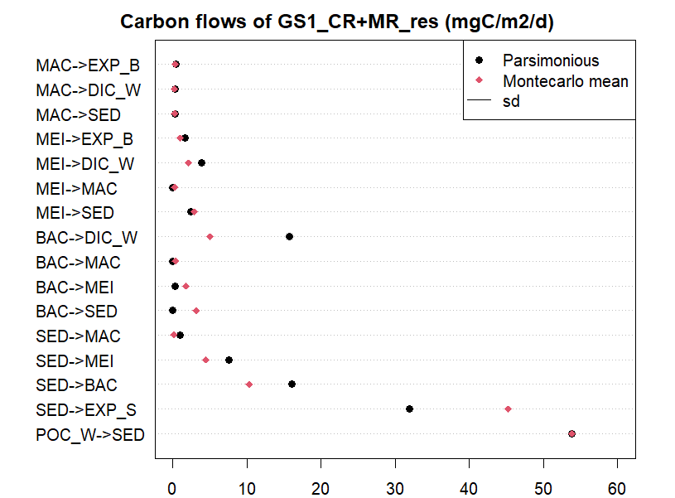
LA Result:
if the range of sampled values cover the range of possible solutions?
Mean sample coverage: 77.51

Slide 22
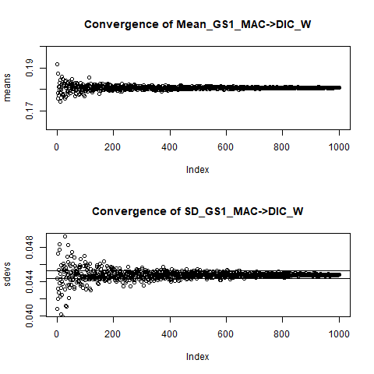
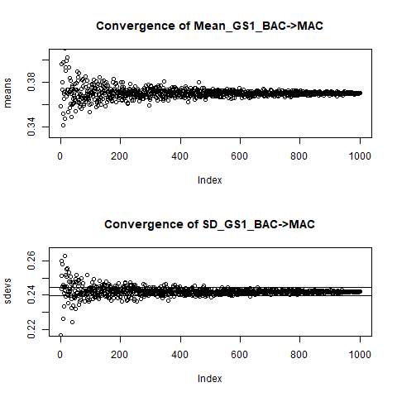
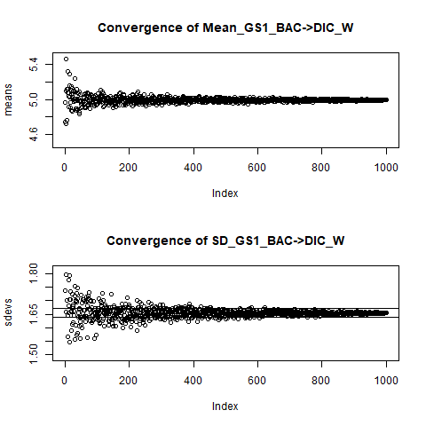
if the number of iterations is high enough to produces convergence of the mean and the standard deviation?
standard deviation < 2%
Check at least 3 different magnitude flows

Slide 23
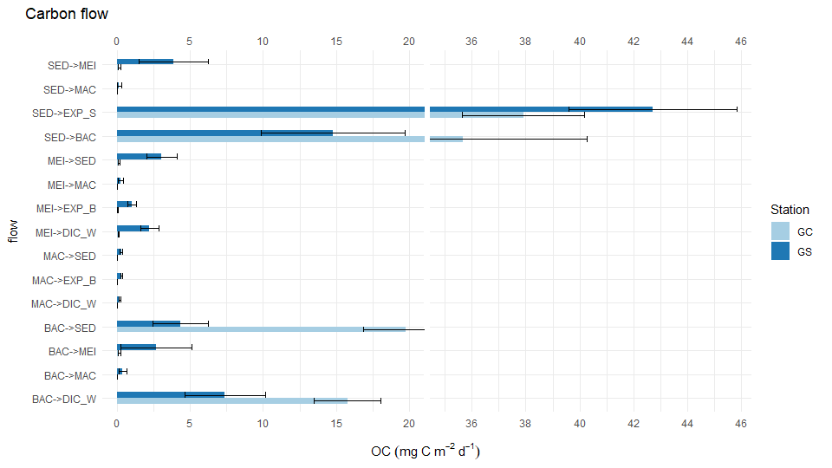
Remove POC->SED (same value was set for 2 sites)

Slide 24
2022.02.11 Meeting
ANOVA: is there seasonality difference between GC1 and GS1?
Yes -> make different season models
No -> used to defend why we only take the mean of biomass data
Figure out the meaning of negative value in parsimonious method
If necessary, change the structure
Check different sedimentation rate in other paper (maybe with seasonal one)/ or use our TOC content to see if there’s difference in input value

Slide 25
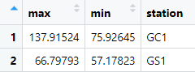
20220322_Fix burial problem
原本: calculate POC_W->SED，讓model 算burial
結果: lsei problem
新方法: calculate accumulation (體積*our TOC% ) and set as a constant，讓model 算POC
(Huh et al., 2009)
Average sedimentation rate in the upper slope region (200–600 m) is 0.43 g cm2 yr1->GS1
higher mass accumulation rates (>1.0 g cm2 yr1 ) ->GC1 (flanking the Gaoping submarine canyon over the upper slope region at a water depth 300 m.) This high deposition area corresponds to the area characterized by flood sedimentation.
Steps:
1. Convert g/cm2/y -> g/m2/d (by *10000/365)
2. Calculate measured TOC(in %->/100) mean and sd
3. g/m2/d * TOC *1000=mg C/m2/ d

Slide 26
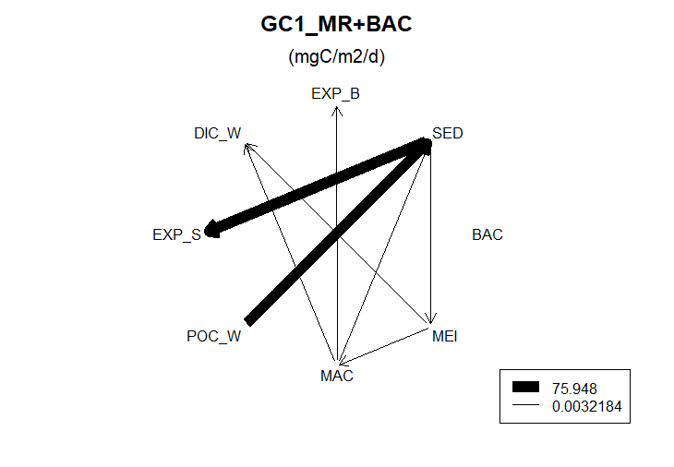
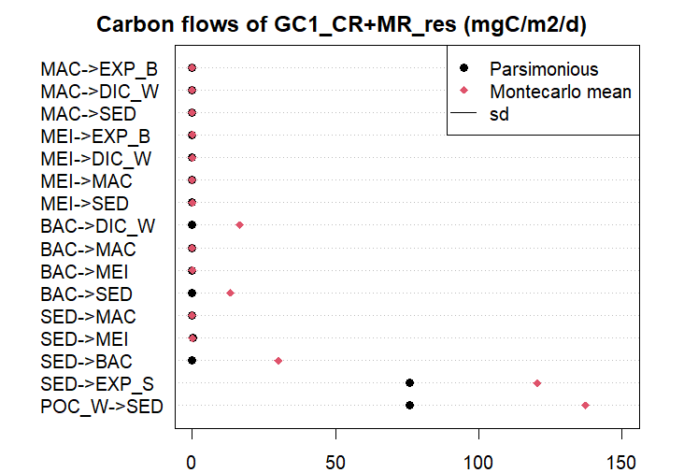
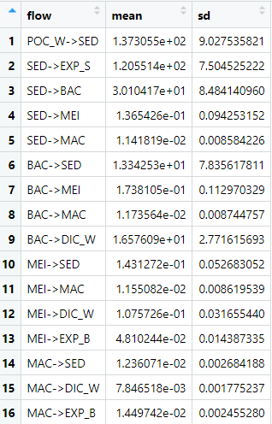
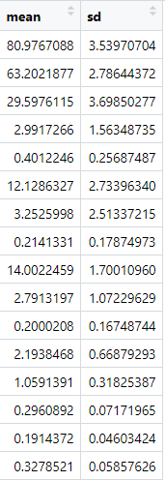

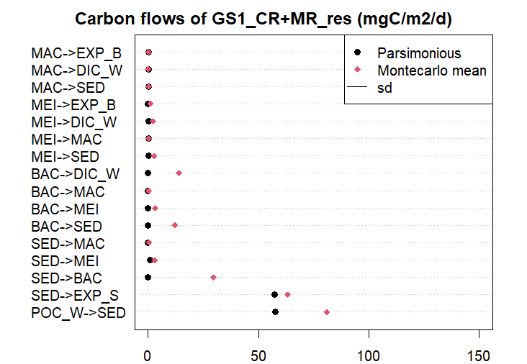
GC1
GS1

